Slide 1
Zoned Namespaces SSD for CSD Project
BAI Shuhan

Slide 2
Agenda
Why we need ZNS with CSD?
∙ LevelDB/RocksDB is an important application of CSD project;
∙ ZNS overcomes following drawbacks:
1. log-on-log / stacking log;
2. semantic gap.
Why not OCSSD?
What is ZNS?
∙ Basic Concepts;
∙ Append Command;
∙ Linux Stack: Adding ZNS support / QEMU

Slide 3
Why we need ZNS with CSD？

Slide 4
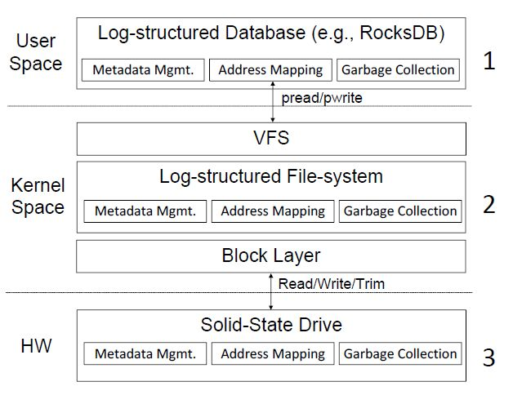
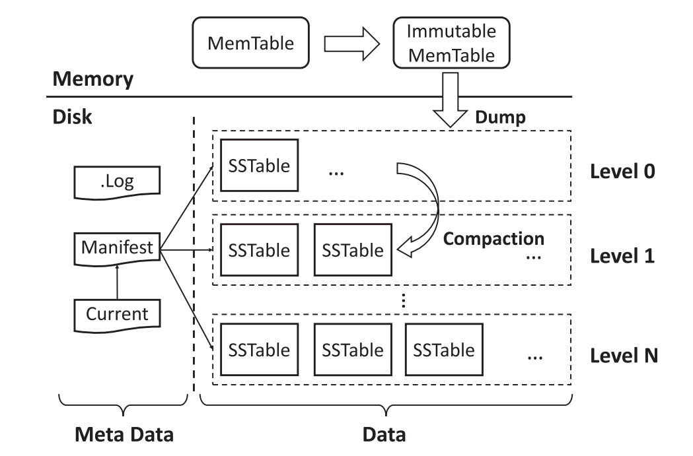
1.
Metadata Mgmt.:
1. write the log for write queries;
2. file Manifest records the valid SSTables after
each compaction;
3. file Current records the current valid Manifest.
Address Mapping: key indexing.
Garbage Collection: compaction.

Slide 5
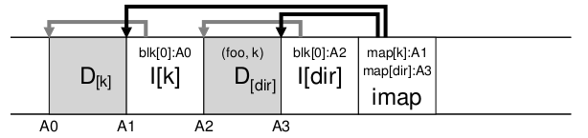
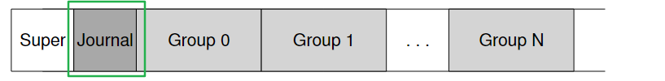
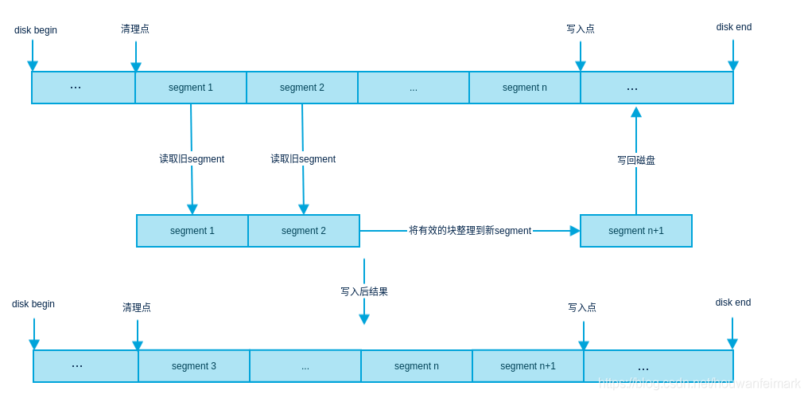
2.
imap[dir]:
A4
CR
0
A4
Metadata Mgmt.: Journal/CR/Inode/imap;
Address Mapping: Inode num
-> data logical addr;
Garbage Collection: cleaning.

Slide 6
3.
Metadata Mgmt.: page states;
Address Mapping: L2P mapping table;
Garbage Collection: GC.
Summary:
User: log-write befor write queries/metadata files;
Kernel: journal/metadata;
HW: remapping of writes and GC.
log-on-log / stacking log
problems occur:
1. flash devices have limited endurance and any additional writes caused by multiple log layers can impact
device lifetime; WA caused by log layers can impact device performance;
2. each layer's log-remapping engine frequently reserves some capacity for GC and only exposes part of its
usable capacity to the upper layer, thus a large fraction of flash media can be consumed as reserve capacity
by multiple logs stacked atop it.
3. the high performance of flash devices implies that log “aging”, or the need for GC to defragment the log,
occurs quickly frequently, and incoherently amongst all the logs involved. This critically impacts overall
performance and endurance,further.
redundant functionality

Slide 7
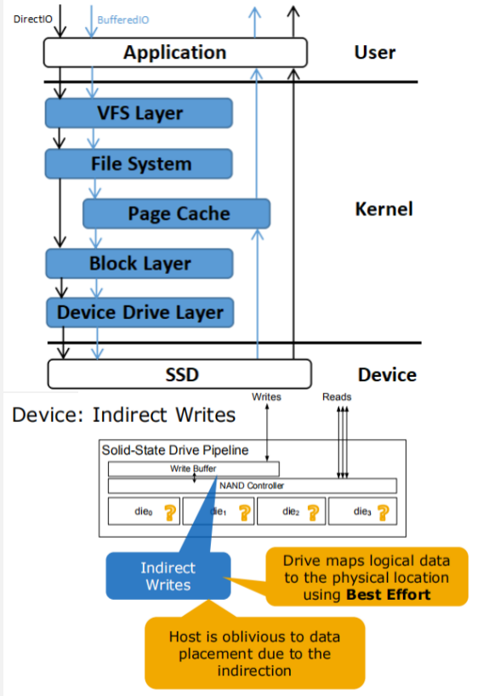
Commercial SSDs adopt FTL to cover the limitations of NAND flash.
To support the legacy storage systems, FTL abstracts the flash device as a block device to the kernel, which builds a semantic gap between the system software and the hardware device.
semantic gap
problems occur:
1. the unawareness between applications and SSDs:
1) the large degree of internal parallelism of SSDs has not been
well-leveraged e to the key-value stores and the file systems;
2) the domain knowledge of applications has not been exploited,
as being considered as normal applications by I/O stacks in
the kernel.
2. unpredictable IO latency;
3. isolation between different user IOs cannot be guarantee.

Slide 8

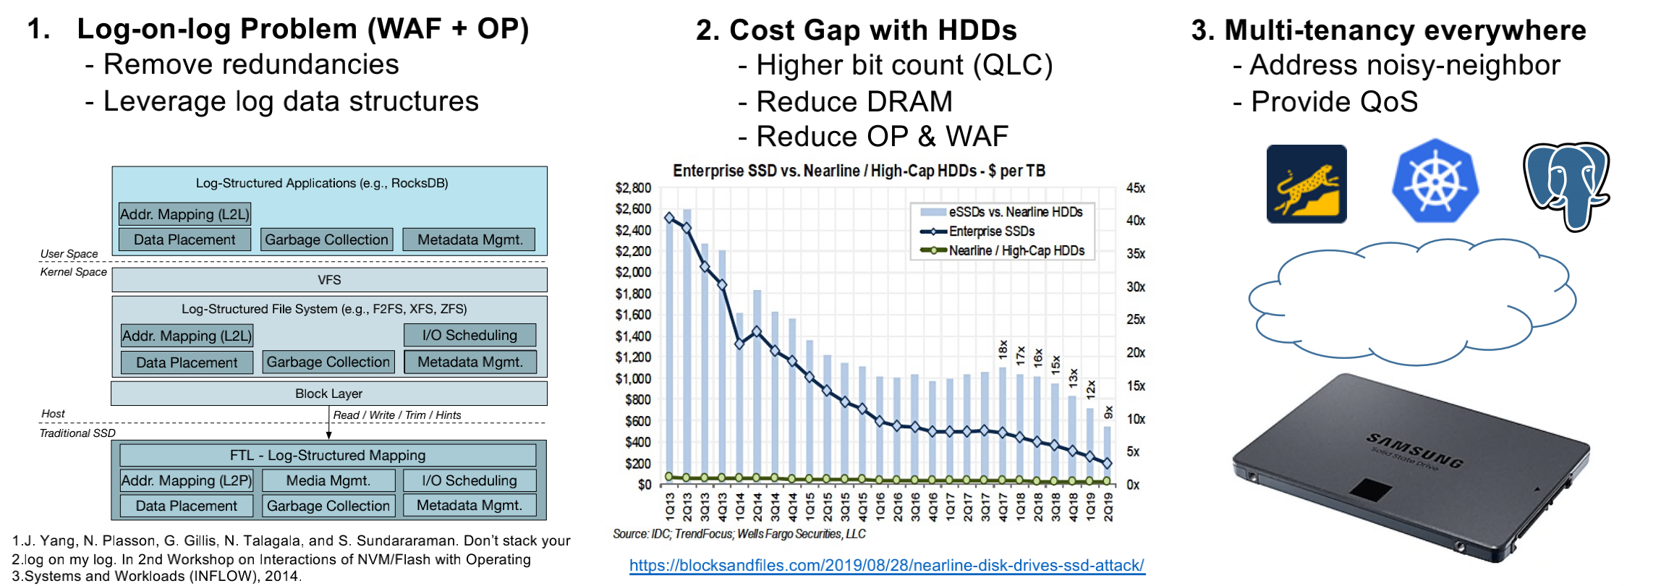
Why we need ZNS？
1. stacking log / redundant functionality; 2. semantic gap.

Slide 9
Why not OCSSD？
Customized FTL is needed, generalization is difficult to achieve.

Slide 10
What is ZNS？

Slide 11
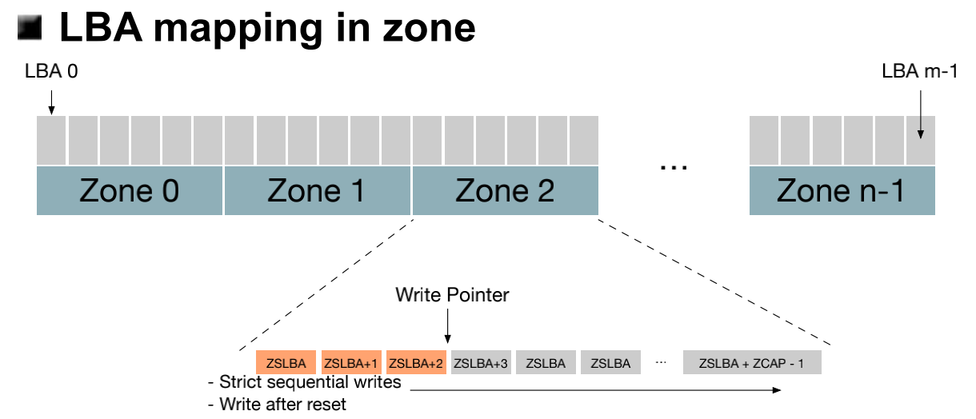
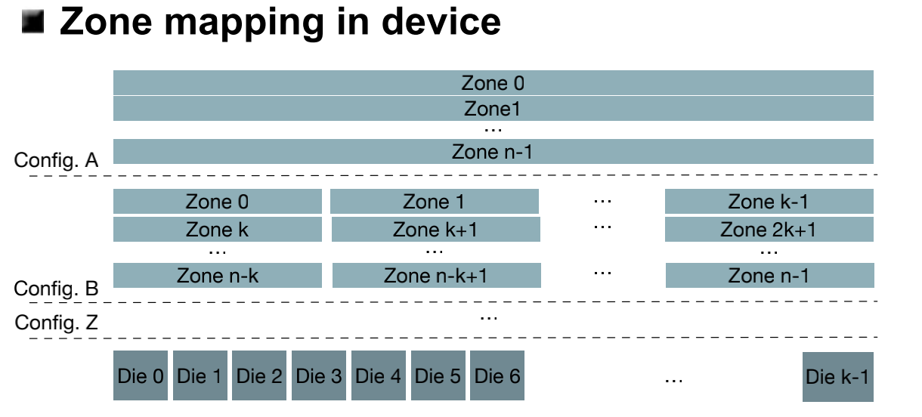
ZNS: Basic Concepts
Zoned Storage Devices
Divide LBA address space
in fixed size zones
• Write Constraints
- Write strictly sequentially within a zone
(Write Pointer)
- Explicitly reset write pointer
• No zone mapping constraints
- Zone physical location transparent to host
- Open design space for different
configuration
horizontal
divide
vertical
divide

Slide 12
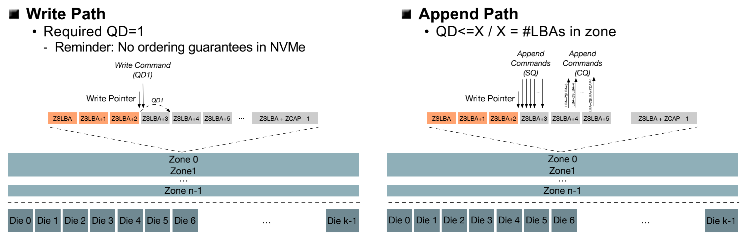
ZNS: Append Command
Implementation of nameless write
Benefits: Increase QD in a single zone to improve parallelism

Slide 13
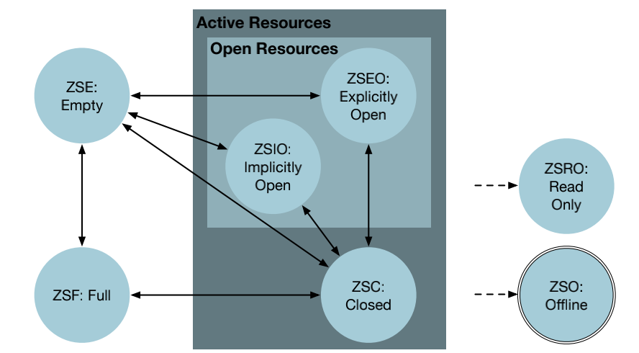
ZNS: Basic Concepts
Zone state machine
• Zone transitions managed by host
- Direct commands or boundaries
• Zone transitions triggered by device
- Notification to host through
a exception

Slide 14
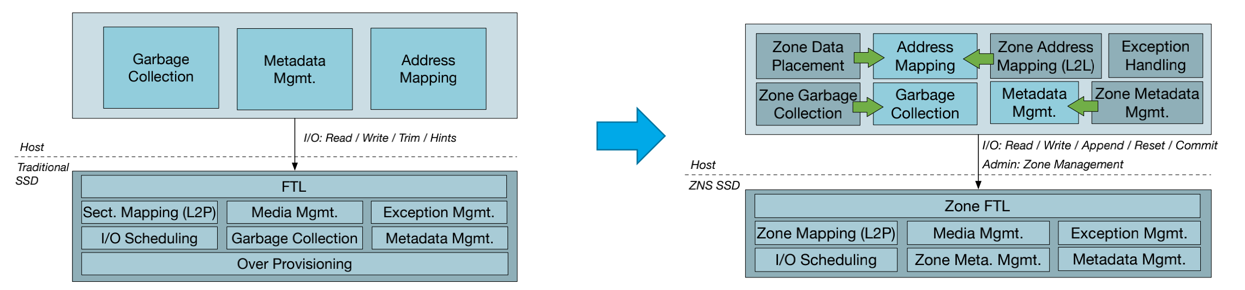
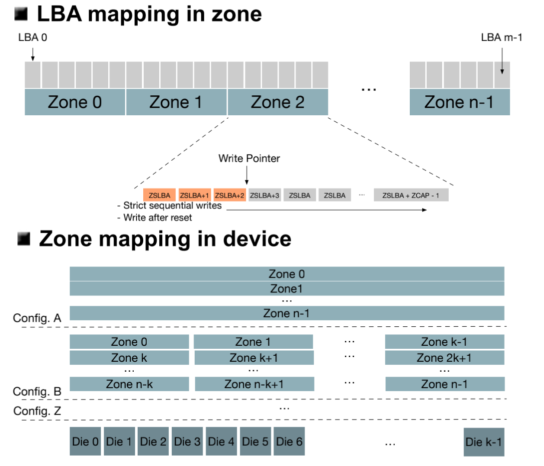
Zoned Namespaces (ZNS) SSDs

Slide 15
Zoned Namespaces (ZNS) SSDs
NVMe ZNS SSDs can provide several benefits over conventional NVMe SSDs.
1. Reducing device-side write amplification leading
to improved throughput and latencies;
2. Reducing device-side media over-provisioning;
3. Reducing device-side DRAM utilization;
4. Improved amount of drive writes per day;
log-on-log / stacking log
semantic gap

Slide 16
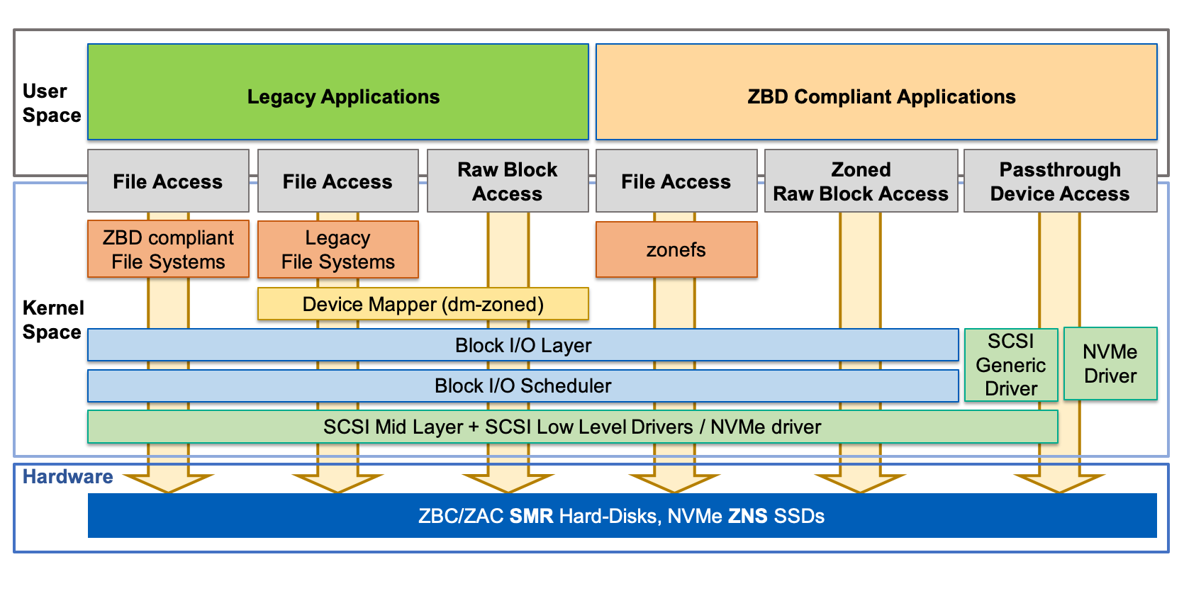
Linux Stack: Adding ZNS support
I/O paths
• Using zoned FS (e.g., F2FS)
- No changes to application
• Using zoned application
- Support in application backend
- Explicit zone management:
Data placement, sched., zone mgmt.
ZNS support in Zoned Block
• Relax assumptions from SMR (ZBC/ZAC)
- Conventional zones
- Zone sizes, state transitions, etc.
• Add support ZNS-specific features
(kernel & tools)
- Append, etc.
QEMU

Slide 17
Q & A?

